Slide 1
JAVA SERVLET PROGRAMMING
Instructor:

Slide 2
Learning Goals
Understand Servlet
Can use Servlet to develop web application

Slide 3
Table Content
Introduction to Servlet
Servlet API
Servlet Request and Response
Servlet Context
Create servlet in Eclipse IDE

Slide 4
Introduction to Servlet
Section 1

Slide 5
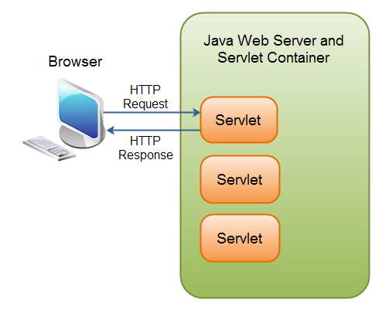
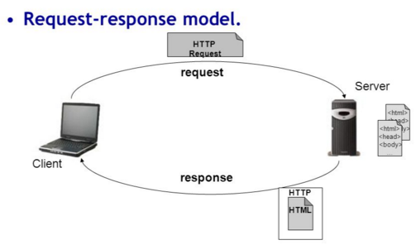
Servlet Overview
Java Servlets are programs that run on a Web or Application server and act as a middle layer between a request coming from a Web browser or other HTTP client and databases or applications on the HTTP server.
Performance is significantly better.
Servlets are platform-independent because they are written in Java.

Slide 6
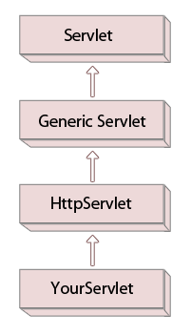
Servlet Architecture
A Servlet is a class, which implements the javax.servlet.Servlet interface.
To write a servlet we need to implement Servlet interface.
Servlet interface can be implemented directly or indirectly by extending GenericServlet or HttpServlet class.
Purpose of extending the HttpServlet class is to provide the HTTP specific services to your servlet.

Slide 7
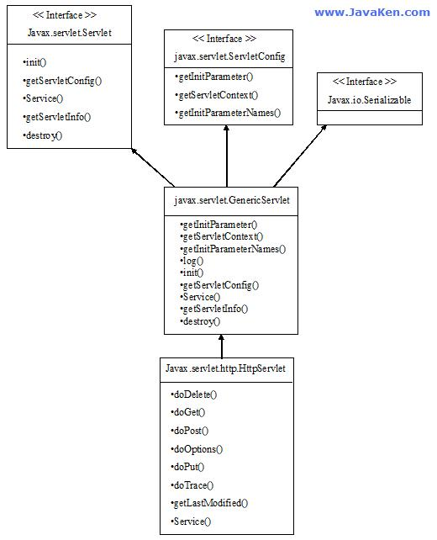
Servlet Architecture

Slide 8
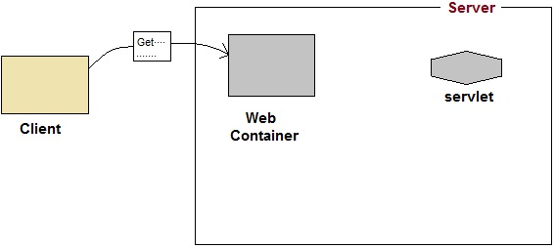
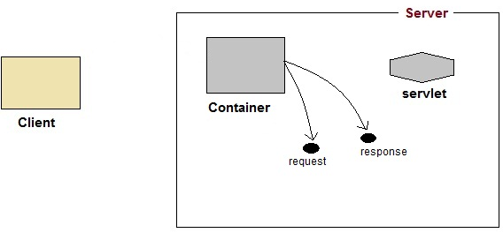
Servlet Application works
Web container is responsible for managing execution of servlets and JSP pages or Java EE application:
User sends request for a servlet by clicking a link that has URL to a servlet.
The container finds the servlet using deployment descriptor and creates two objects:
HttpServletRequest
HttpServletResponse
1
2

Slide 9
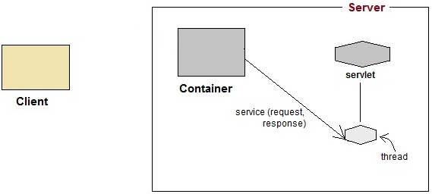
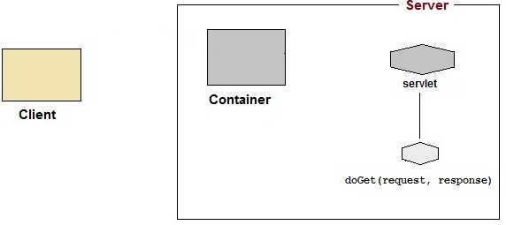
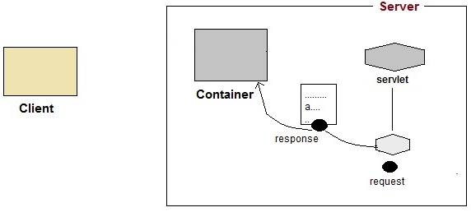
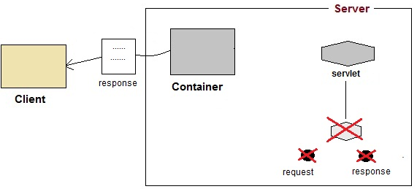
Servlet Application works
Then the container calls the Servlet's service() method and passes the request, response objects as arguments.
The service() method, then decides which servlet method, doGet() or doPost() to call.
Then the Servlet uses response object to write the response back to the client.
3
4
5
6

Slide 10
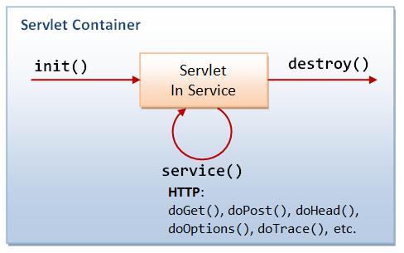
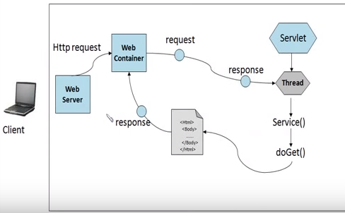
Servlet Life Cycle
A servlet life cycle can be defined as the entire process from its creation till the destruction.
The following are the paths followed by a servlet:
The servlet is initialized by calling the init () method.
The servlet calls service() method to process a client's request.
The servlet is terminated by calling the destroy() method.
Finally, servlet is garbage collected by the garbage collector of the JVM.
Servlet container provides the execution environment for Servlet.
The Web container manages a servlet by invoking various life cycle methods.

Slide 11
Servlet API
Section 2

Slide 12
HttpServlet Class
The HttpServlet class extends the GenericServlet class and implements Serializable interface.
It provides http specific methods such as doGet, doPost, doHead, doTrace etc.
Method doGet responds to get requests
Retrieve the content of a URL.
Method doPost responds to post requests
Post data from an HTML form to a server-side form handler.
Browsers cache Web pages.
HttpServletRequest and HttpServletResponse objects
Created by the servlet container and passed as an argument to the servlet's service methods (doGet, doPost, etc.)
HttpServletRequest object contains request from the client,
HttpServletResponse object provides HTTP-specific functionality in sending a response (access HTTP headers, cookies, etc.)
Notes:
Container
It provides runtime environment for JavaEE (j2ee) applications.
It performs many operations that are given below:
Life Cycle Management
Multithreaded support
Object Pooling
Security etc.

Slide 13
HttpServlet Class
public void service(ServletRequest req,ServletResponse res):
dispatches the request to the protected service method by converting the request and response object into http type.
protected void service(HttpServletRequest req, HttpServletResponse res):
receives the request from the service method, and dispatches the request to the doXXX() method depending on the incoming http request type.
protected void doGet(HttpServletRequest req, HttpServletResponse res):
handles the GET request. It is invoked by the web container.
protected void doPost(HttpServletRequest req, HttpServletResponse res):
handles the POST request. It is invoked by the web container.
protected void doHead(HttpServletRequest req, HttpServletResponse res)
handles the HEAD request. It is invoked by the web container.
protected void doOptions(HttpServletRequest req, HttpServletResponse res)
handles the OPTIONS request. It is invoked by the web container.
protected void doPut(HttpServletRequest req, HttpServletResponse res)
handles the PUT request. It is invoked by the web container.

Slide 14
HttpServlet Class
protected void doTrace(HttpServletRequest req, HttpServletResponse res):
handles the TRACE request. It is invoked by the web container.
protected void doDelete(HttpServletRequest req, HttpServletResponse res)
handles the DELETE request. It is invoked by the web container.
protected long getLastModified(HttpServletRequest req)
returns the time when HttpServletRequest was last modified since midnight January 1, 1970 GMT.

Slide 15
Servlet Request and Response
Section 3

Slide 16
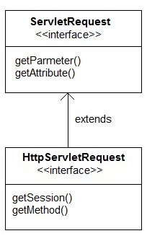


HttpServletRequest
HttpServletRequest interface adds the methods that relates to the HTTP protocol.
Methods (extension/addition method)

Slide 17
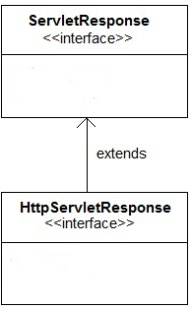

HttpServletResponse
HttpServletResponse interface adds the methods that relates to the HTTP response.
Methods (extension/addition method)

Slide 18
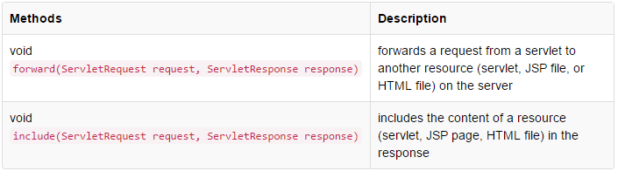
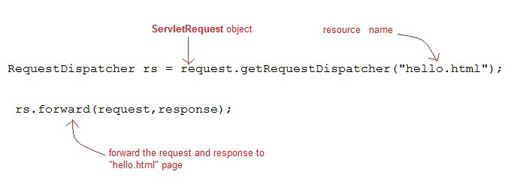
RequestDispatcher
RequestDispatcher is an interface, implementation of which defines an object which can dispatch request to any resources(such as HTML, Image, JSP, Servlet) on the server.
Methods:
Example:

Slide 19
RequestDispatcher
redirection vs request dispatching
The main difference between a redirection and a request dispatching:
redirection makes the client(browser) create a new request to get to the resource, the user can see the new URL;
request dispatch get the resource in same request and URL does not changes.

Slide 20
Create servlet in Eclipse IDE
Section 3

Slide 21
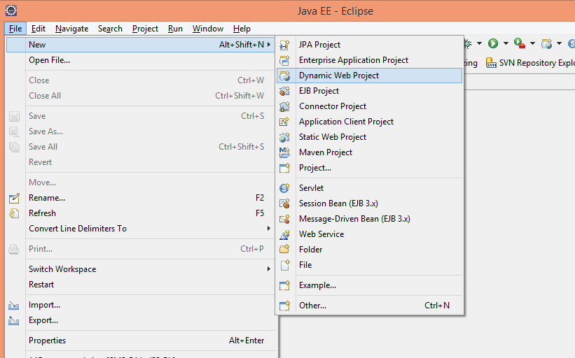
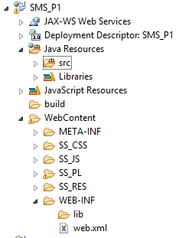
Steps to create Servlet using Eclipse IDE
Create a Dynamic Web Project, give a name to your project (Ex: SMS_P1)
1
2
A directory structure of your Project will be automatically created by Eclipse IDE.

Slide 22
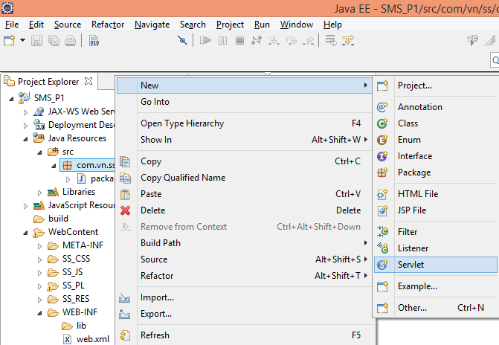
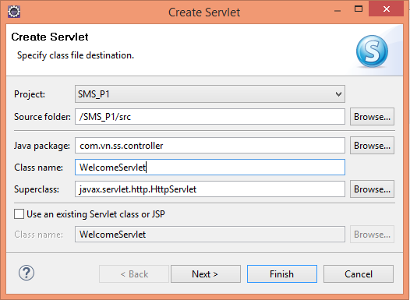
Steps to create Servlet using Eclipse IDE
Create a Servlet class by extends HttpServlet.
Add servlet-api.jar JAR
file to your project

Slide 23

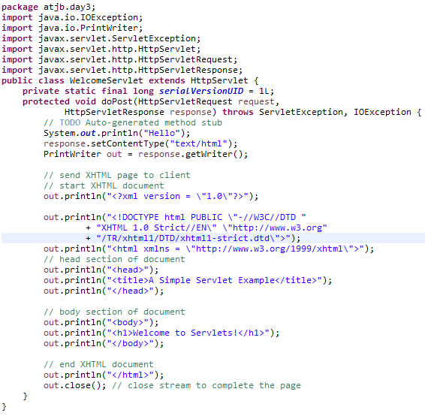
Handling HTTP get Requests
Create a Servlet (WelcomeServlet.java):
Import the javax.servlet and javax.servlet.http packages.
Extends HttpServlet to handle HTTP get requests and HTTP post requests.
doGet
Override method doGet to provide custom get request processing.
Uses the response object’s setContentType method to specify the content type of the data to be sent as the response to the client.
Uses the response object’s getWriter method to obtain a reference to the PrintWriter object that enables the servlet to send content to the client.
Create the XHTML document by writing strings with the out object’s println method.
Closes the output stream, flushes the output buffer and sends the information to the client.

Slide 24
Create Deployement Descriptor
1 <!DOCTYPE web-app PUBLIC
2 "-//Sun Microsystems, Inc.//DTD Web Application 2.2//EN"
3 "http://java.sun.com/j2ee/dtds/web-app_2_2.dtd">
4
5 <web-app>
6
7 <!-- General description of your Web application -->
8 <display-name>
9 Sample
10 Servlet Examples
11 </display-name>
12
13 <description>
14 This is the Web application in which we
15 demonstrate our JSP and Servlet examples.
16 </description>
17
18 <!-- Servlet definitions -->
19 <servlet>
20 <servlet-name>welcome</servlet-name>
21
22 <description>
23 A simple servlet that handles an HTTP get request.
24 </description>
25
26 <servlet-class>
27 atjb.day3.WelcomeServlet
28 </servlet-class>
29 </servlet>
30
Deployment descriptor (web.xml) for the Web application.
Element web-app defines the configuration of each servlet in the Web application and the servlet mapping for each servlet.
Element display-name specifies a name that can be displayed to the administrator of the server on which the Web application is installed.
Element description specifies a description of the Web application that might be displayed to the administrator of the server.
Element servlet describes a servlet.
Element servlet-name is the name for the servlet.
Element description specifies a description for this particular servlet.
Element servlet-class specifies compiled servlet’s fully qualified class name.

Slide 25
Create Deployement Descriptor
31 <!-- Servlet mappings -->
32 <servlet-mapping>
33 <servlet-name>welcome</servlet-name>
34 <url-pattern>/welcomeServlet</url-pattern>
35 </servlet-mapping>
36
37 </web-app>
Element servlet-mapping specifies servlet-name and url-pattern elements.

Slide 26
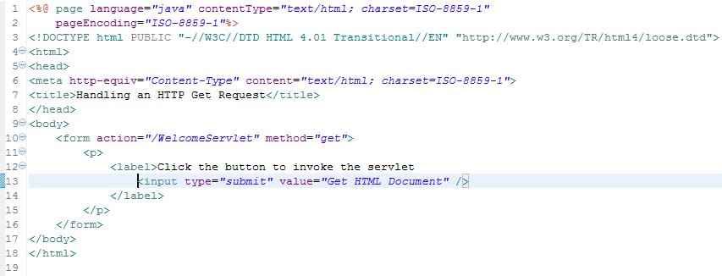
Handling HTTP get Requests
Jsp page in which the form’s action invokes WelcomeServlet through the alias welcome specified in web.xml.
Example: Welcome.jsp

Slide 27
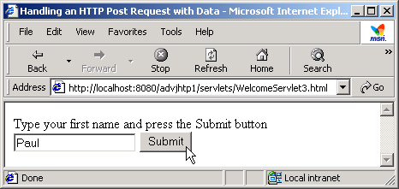
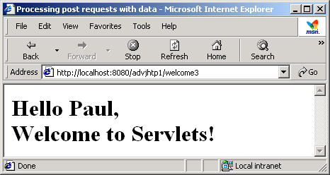
Handling HTTP post Requests
HTTP post request
Post data from an HTML form to a server-side form handler
Browsers cache Web pages
Practices time:
Let’s try to see differences between HTTP post and HTTP get requests
Use HTTPServletRequest’s getParameter method() to get param value

Slide 28
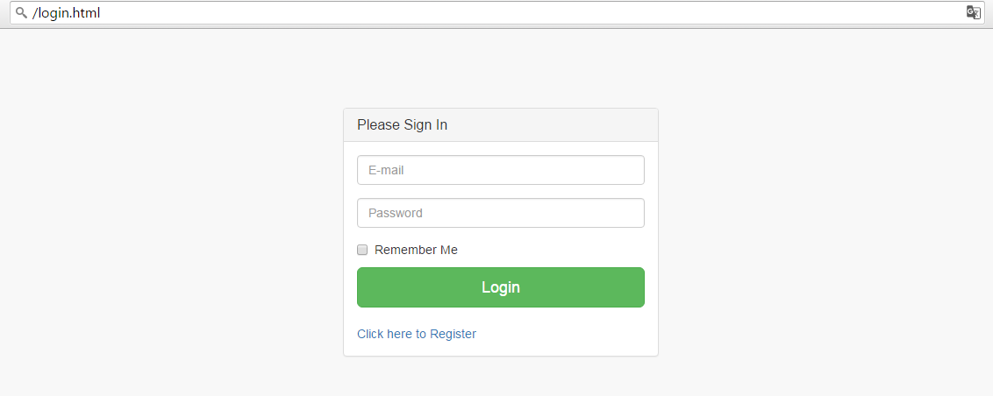
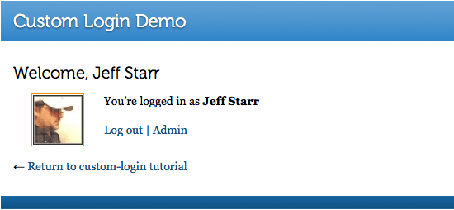
Practices time
Handling HTTP post Requests sample:
<form action="${pageContext.request.contextPath}/WelcomeServlet?" method="post">
User Login

Slide 29
Summary
Introduction to Servlet
Servlet API
Servlet Request and Response
Servlet Context
Create servlet in Eclipse IDE

Slide 30

Thank you
30

